Slide 1
GB ENS
Standalone and as an additional service
User guide

Slide 2
GB ENS Standalone

Slide 3
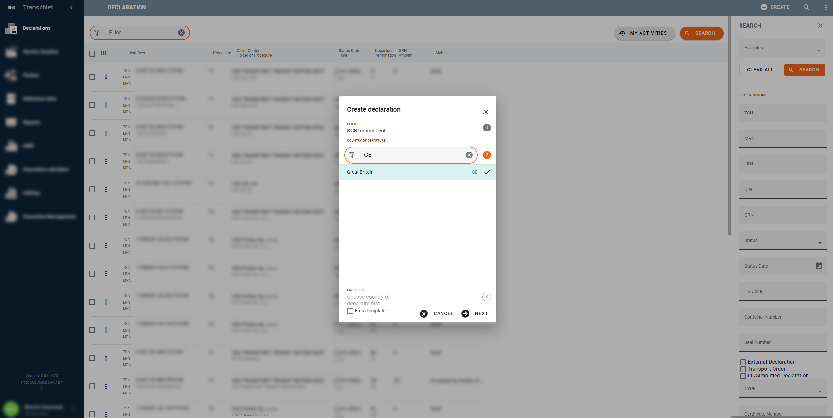
GB ENS Standalone
Go to declarations
Press Create
Select Country of departure = Great Britain
Press Next

Slide 4
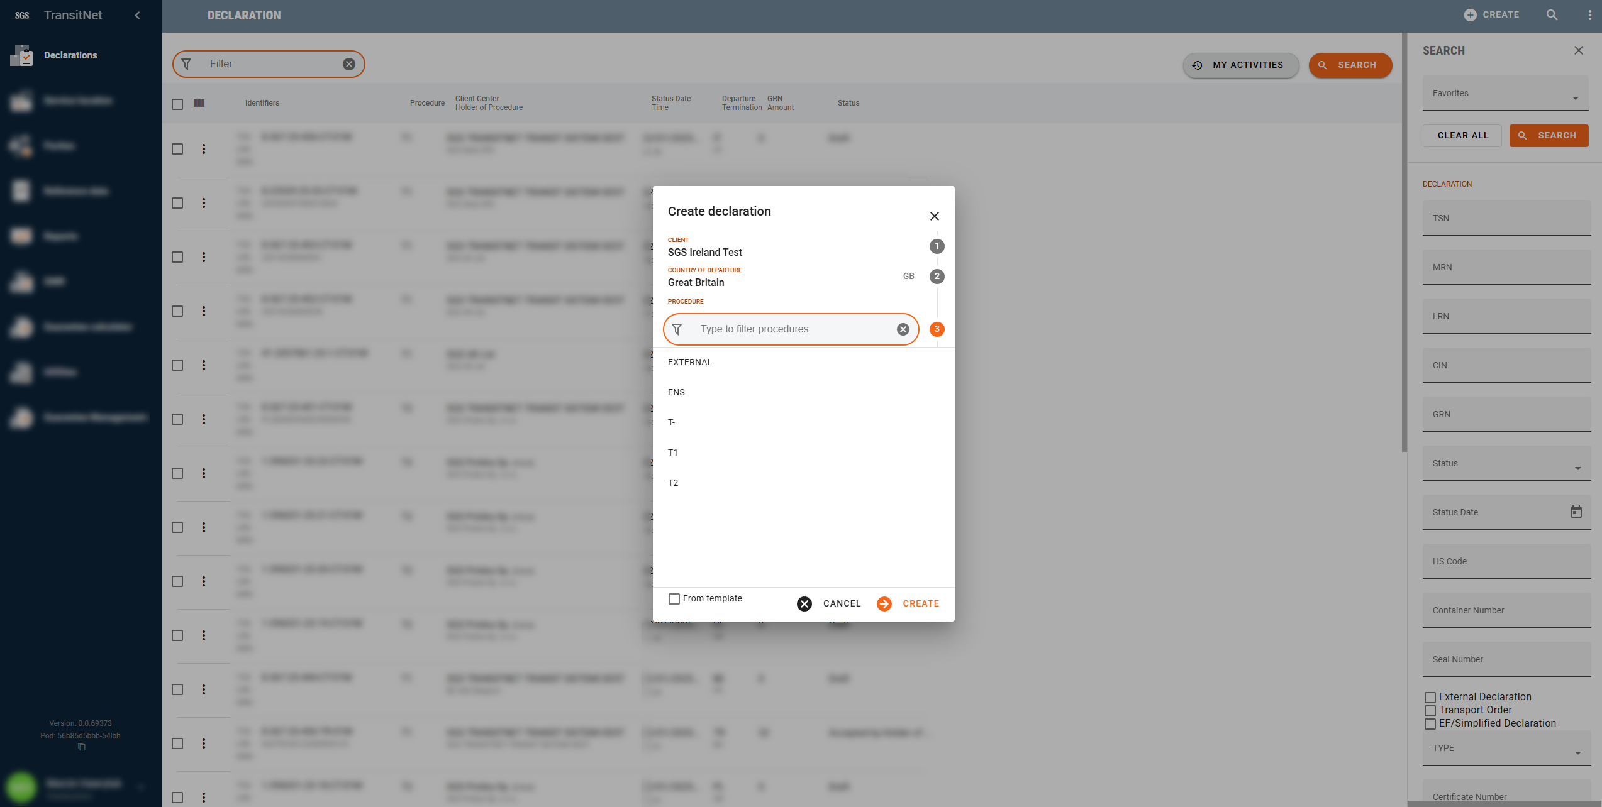
GB ENS Standalone
Select Procedure = ENS
Press Create

Slide 5
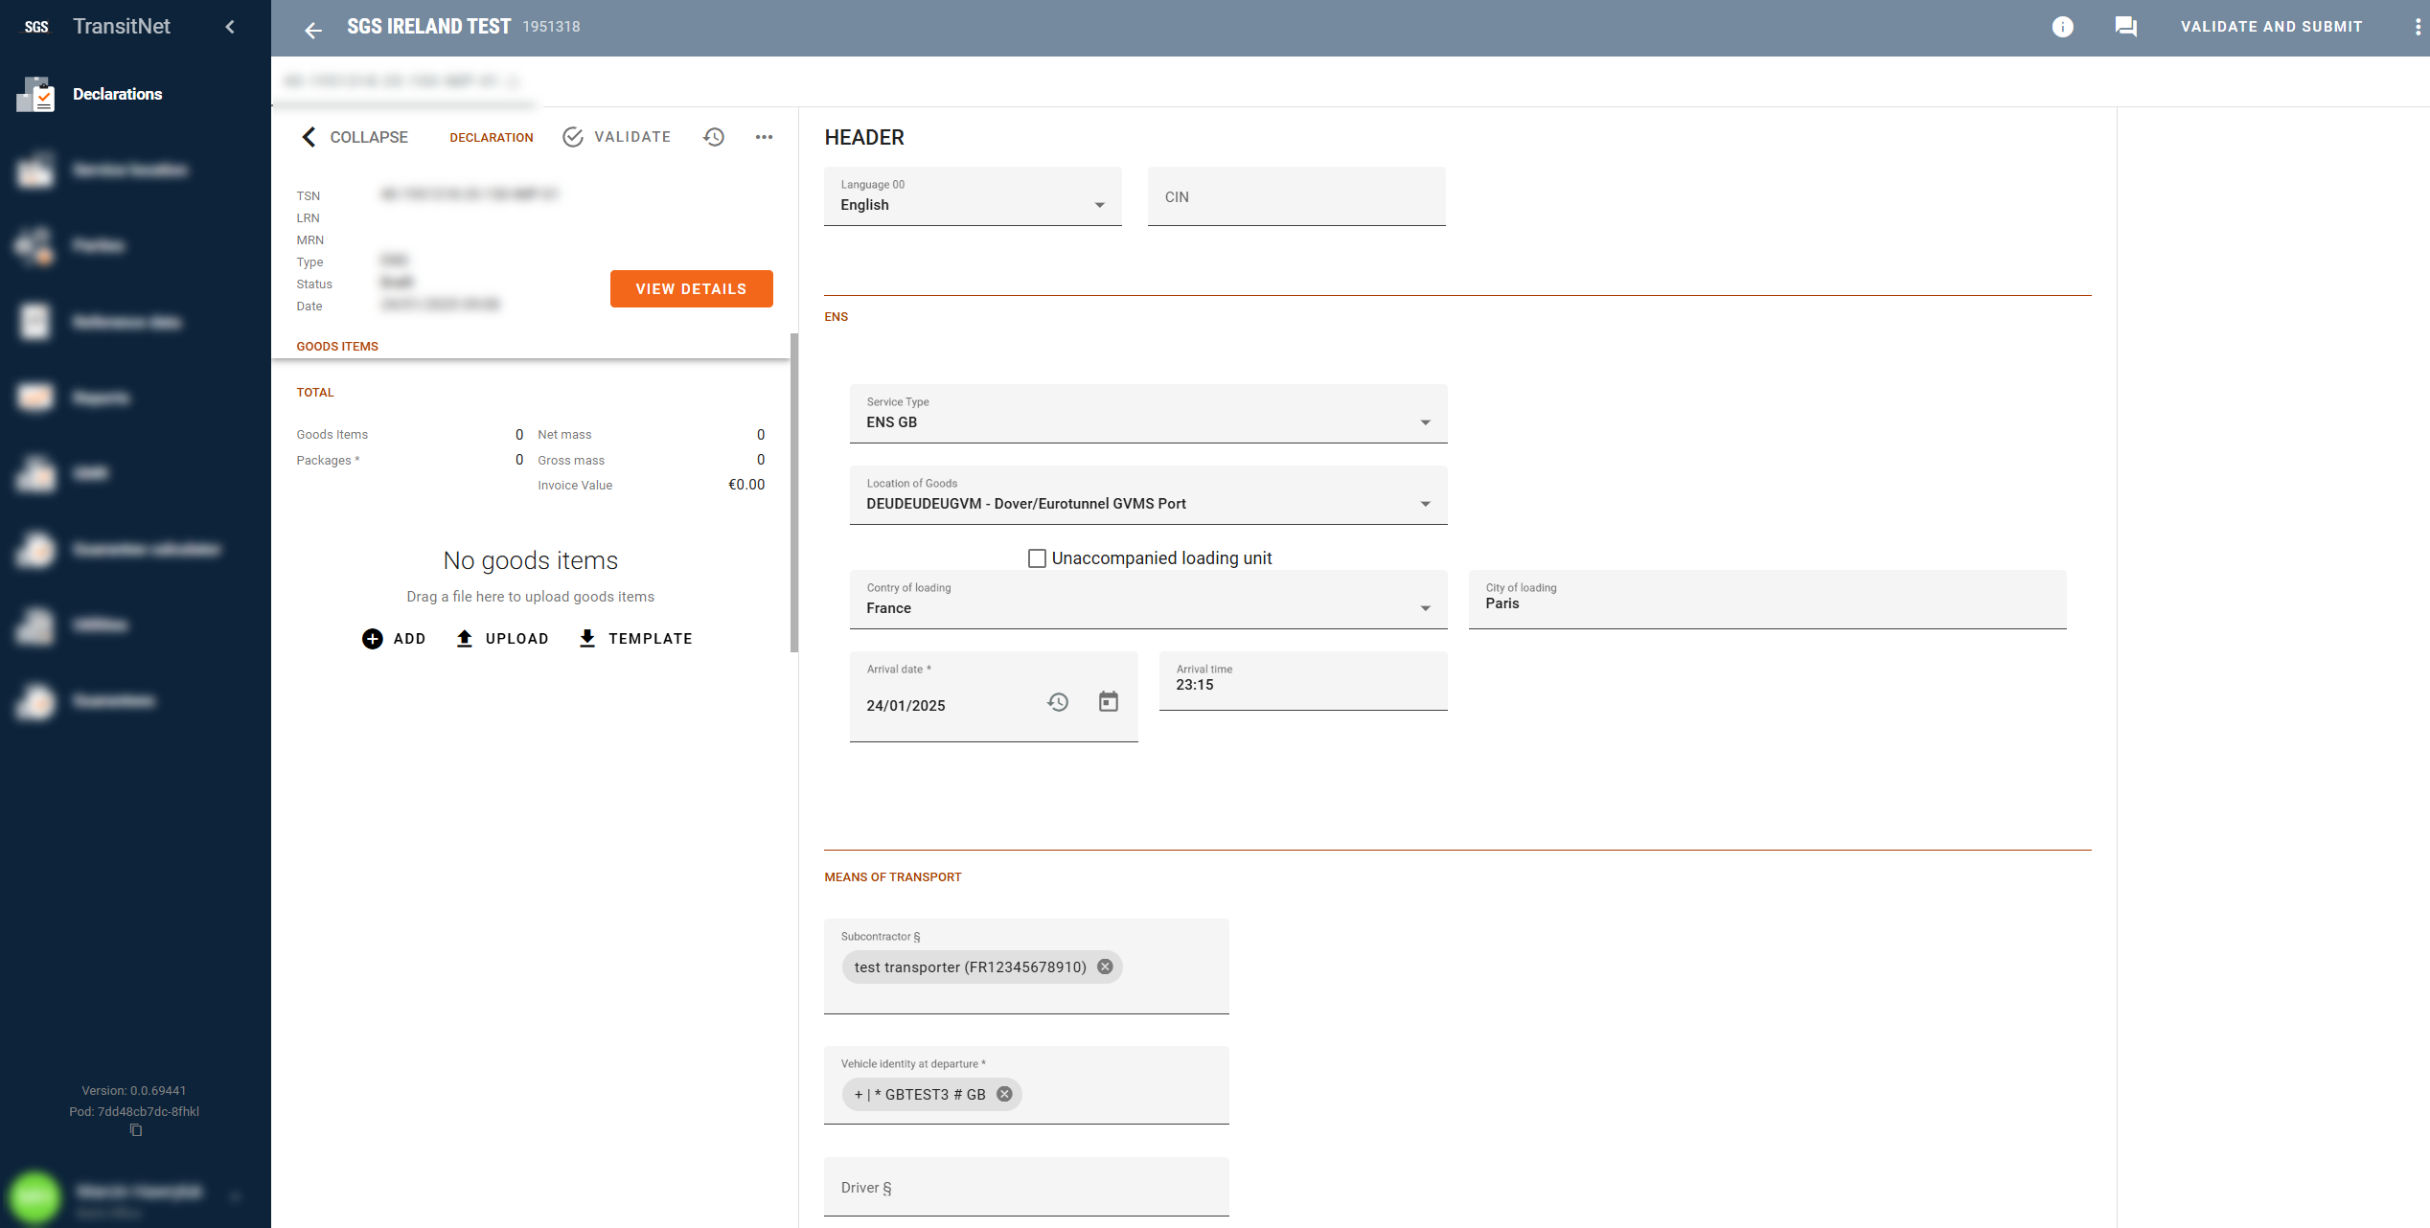
GB ENS Standalone
Add CIN if necessary
Choose Location of Goods (this depends on the port of entry and the carrier (ferry company/Eurotunnel))
Complete:
•Country of loading
•Place of loading
•Arrival date (enter the arrival date of ferry/tunnel into GB)
•Arrival time (enter the arrival date of ferry/tunnel into GB)
For unaccompanied transports, check the Unaccompanied loading unit box
Add transport details including subcontractor (if applicable) and registration plate numbers
Scroll down

Slide 6
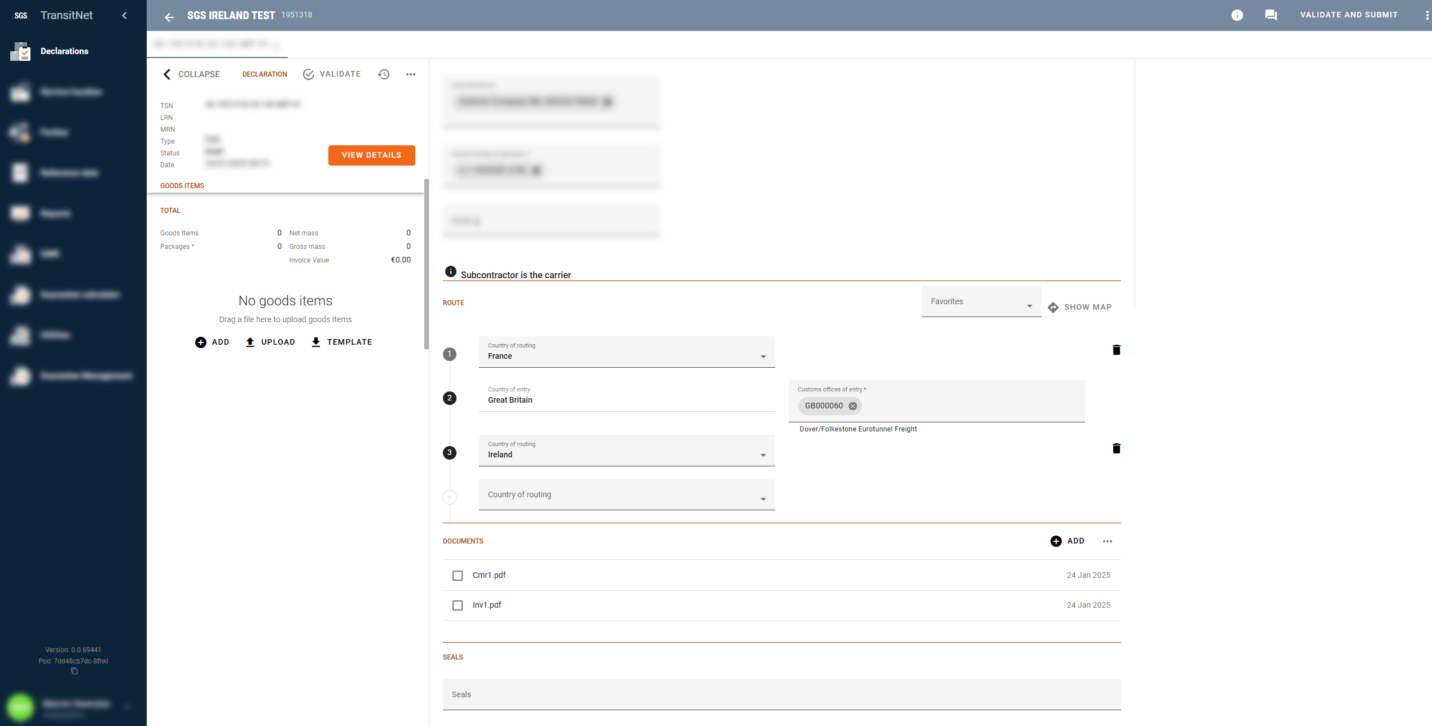
GB ENS Standalone
Add Customs office of entry (where the goods will enter Great Britain)
Add routing of goods – hover over the number and press + to add routing before or after Great Britain
Press ADD to add new good item
Upload documents
Add seals if applicable

Slide 7
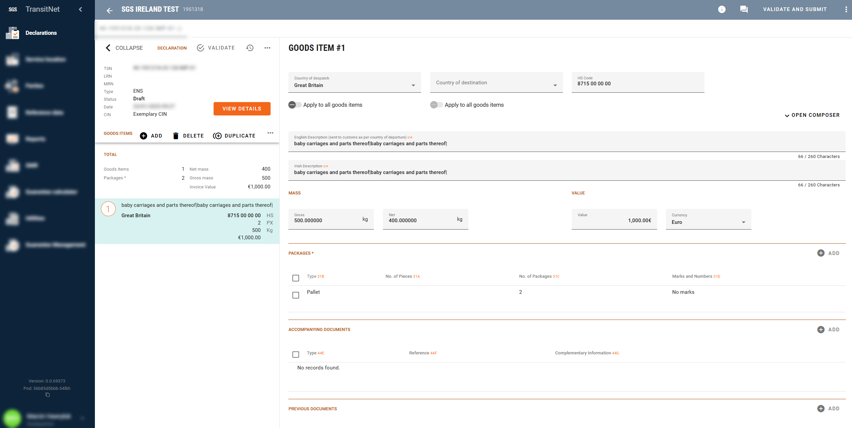
GB ENS Standalone
Add Country of dispatch and Country of destination
Add accurate description of all goods in English language (HS codes are not mandatory for GB ENS) – IMPORTANT: each combination of consignor and consignee will require a separate Good Item
Add Package information (Type of packages, Number of Packages and Marks and Numbers)
Add Gross Mass and invoice value
Scroll down

Slide 8
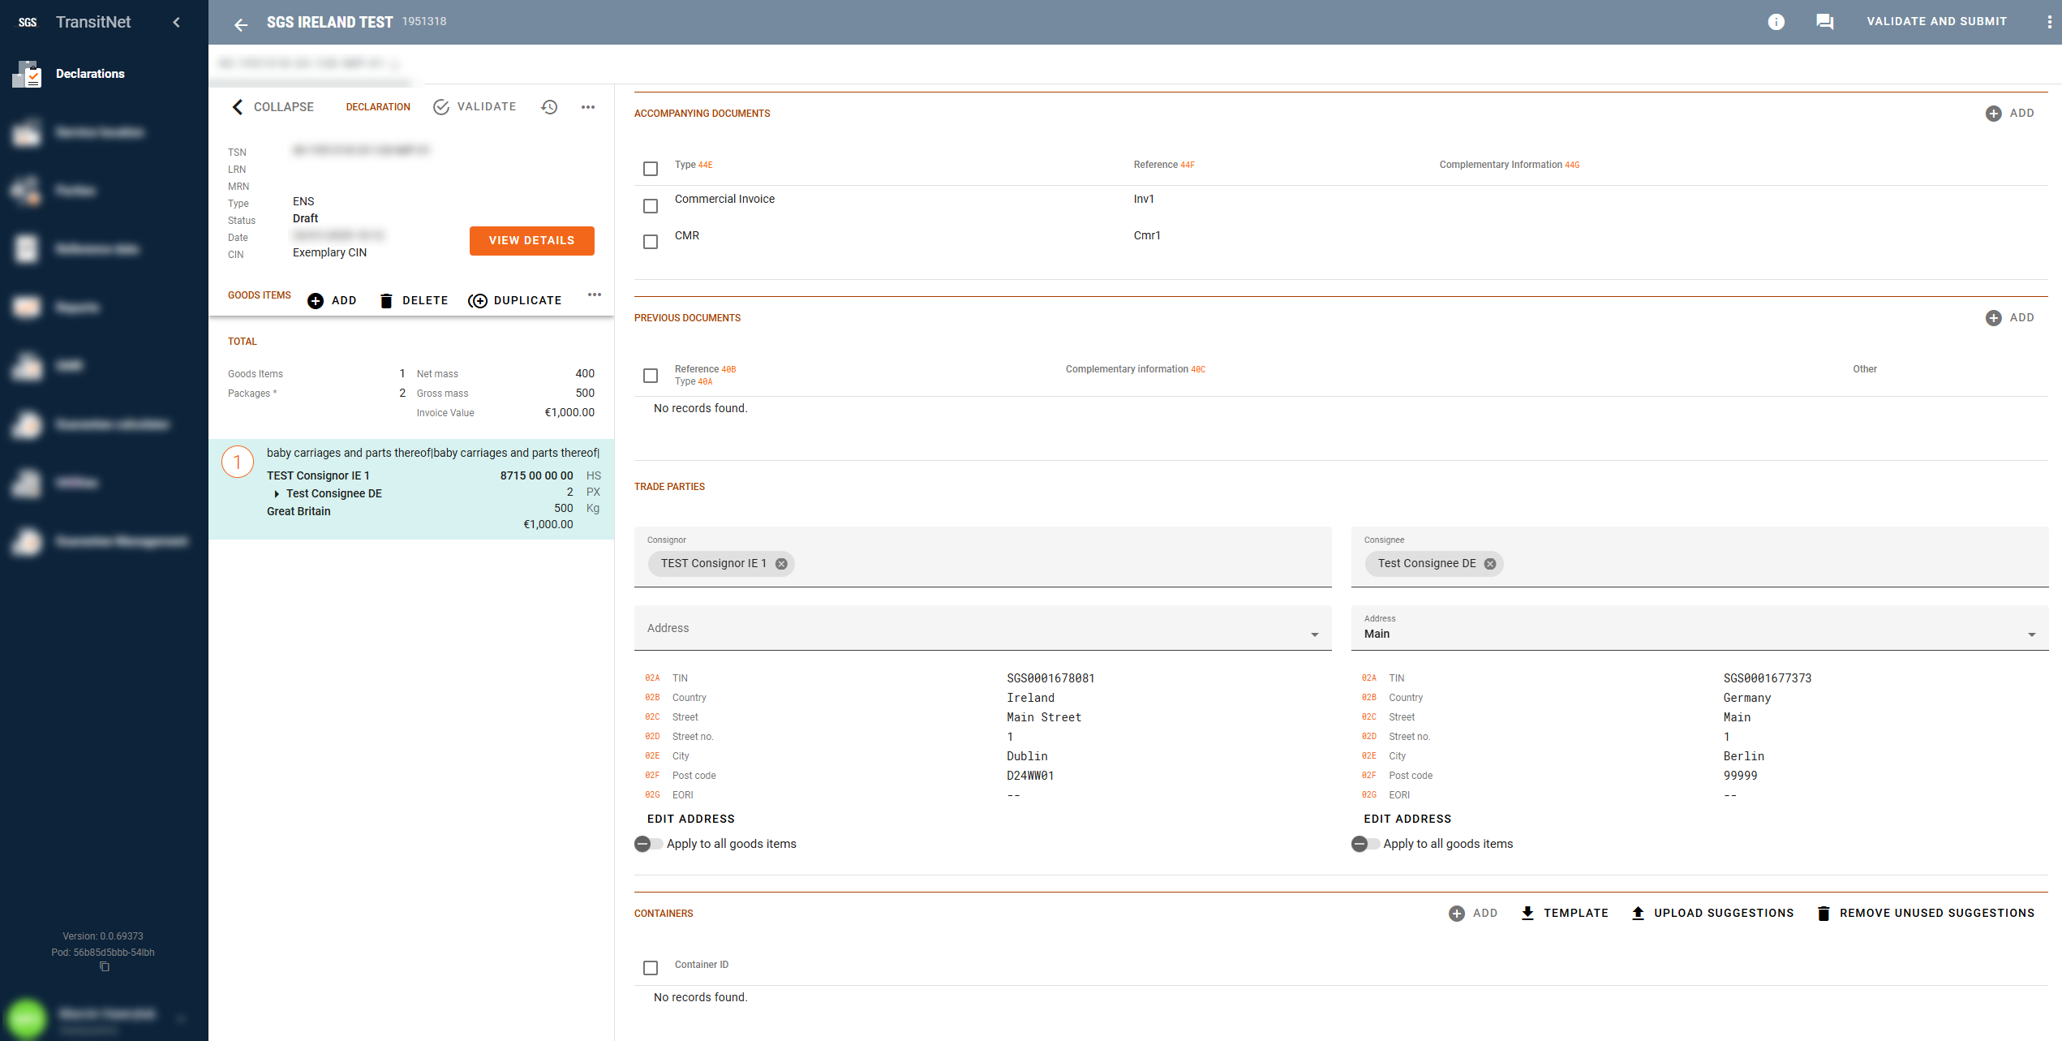
GB ENS Standalone
Press Validate and Submit to submit ENS declaration
Add document type CMR as Accompanying Documents – It is mandatory to add a CMR for road movements into Great Britain
Add Consignor and Consignee
Add Container number if applicable

Slide 9
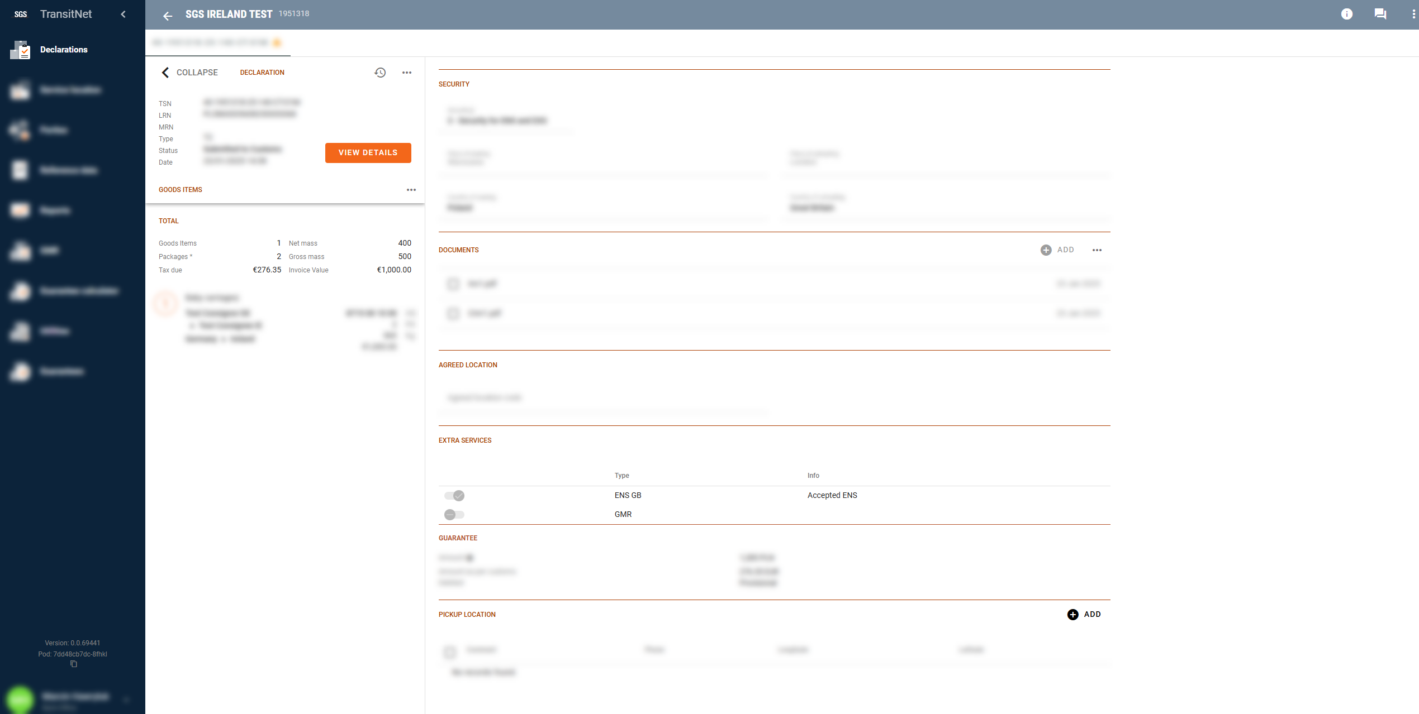
GB ENS Standalone
After submission of the transits, ENS will be generated. Successful ENS submission is shown in UI

Slide 10
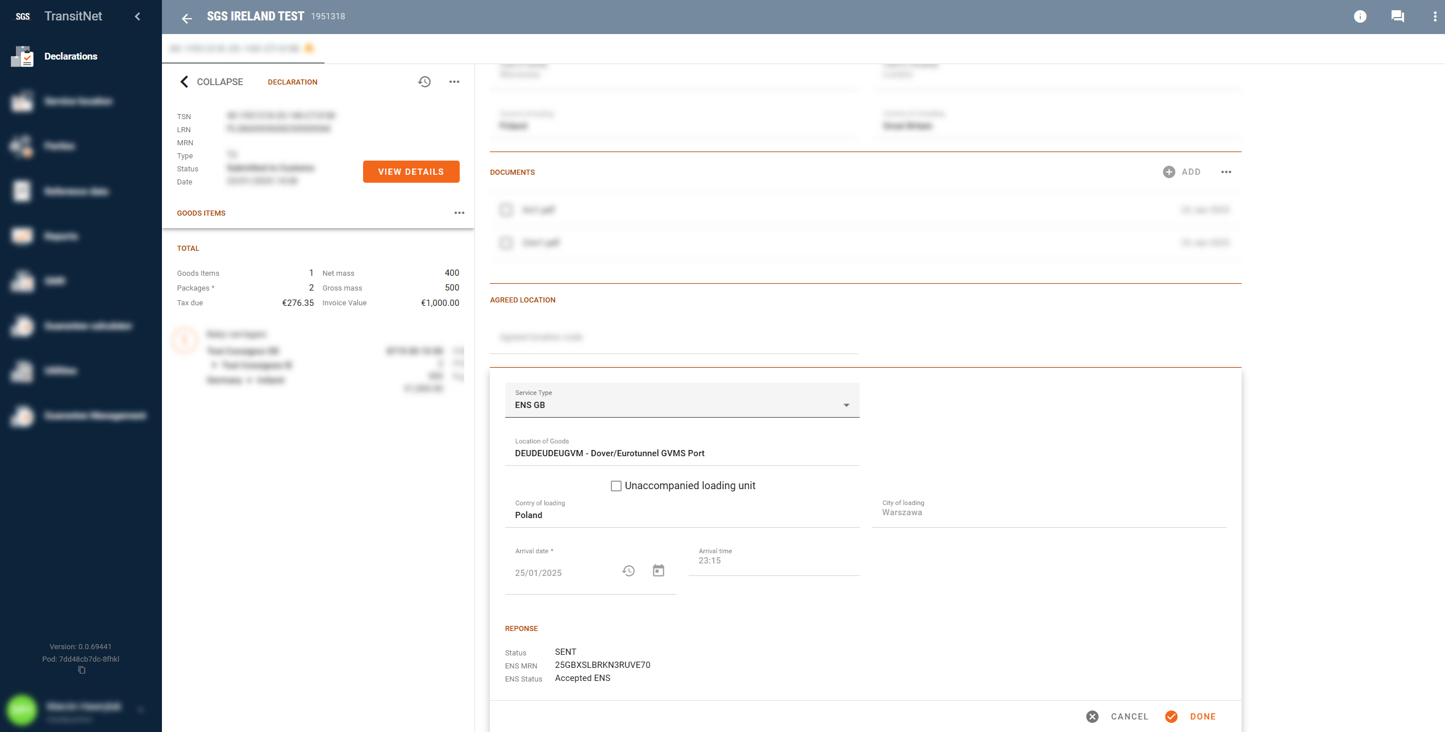
GB ENS Standalone
Information about accepted and rejected ENS submissions will also be sent by no reply email message to your registered email addresses
In case of rejected ENS submissions, please contact your local Client Centre

Slide 11
GB ENS as AN ADDITIONAL SERVICE

Slide 12
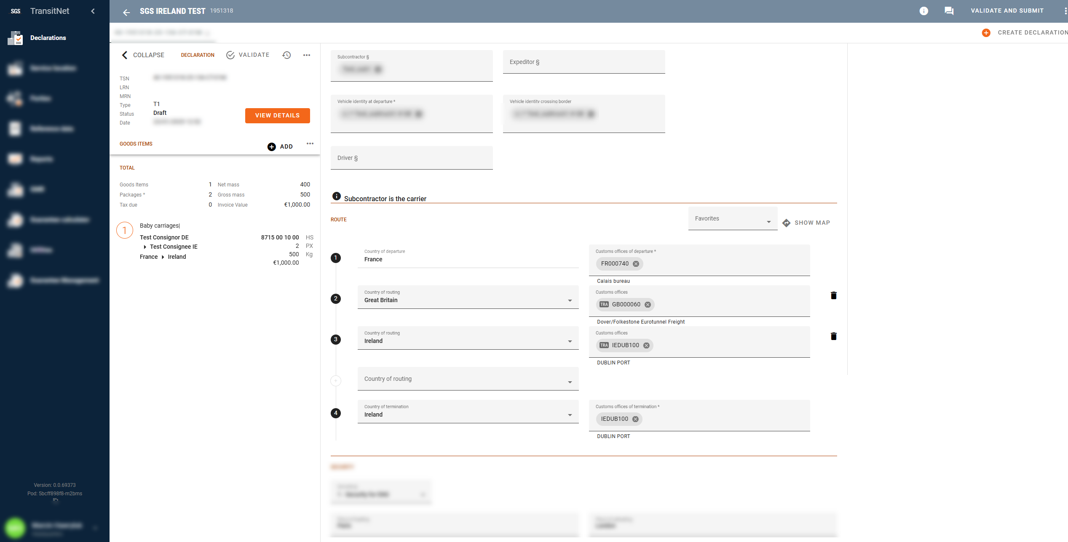
GB ENS AS AN ADDITIONAL SERVICE
The availability of GB ENS as an additional service is triggered when a Customs office of transit is included in the Route section
Scroll down to Extra Services section

Slide 13
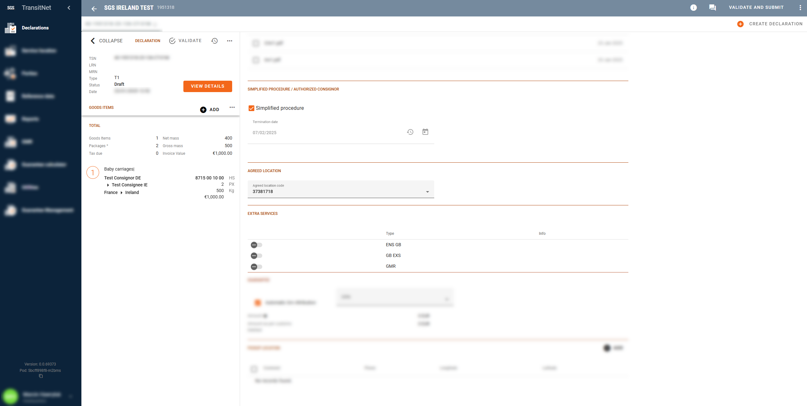
GB ENS AS AN ADDITIONAL SERVICE
Check the box to activate GB ENS as an additional service

Slide 14
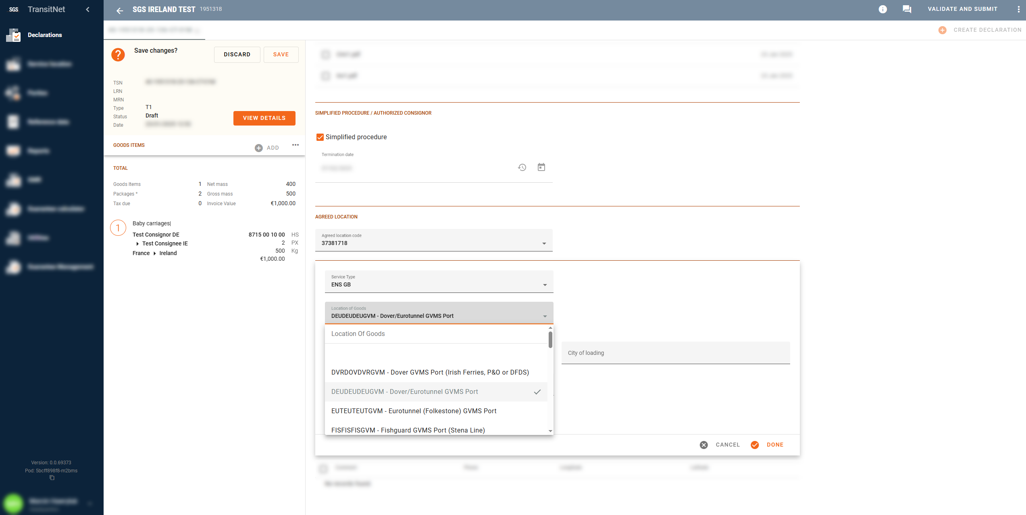
GB ENS AS AN ADDITIONAL SERVICE
Choose the Location of Goods (this depends in the port of entry and the carrier (ferry company/Eurotunnel))

Slide 15
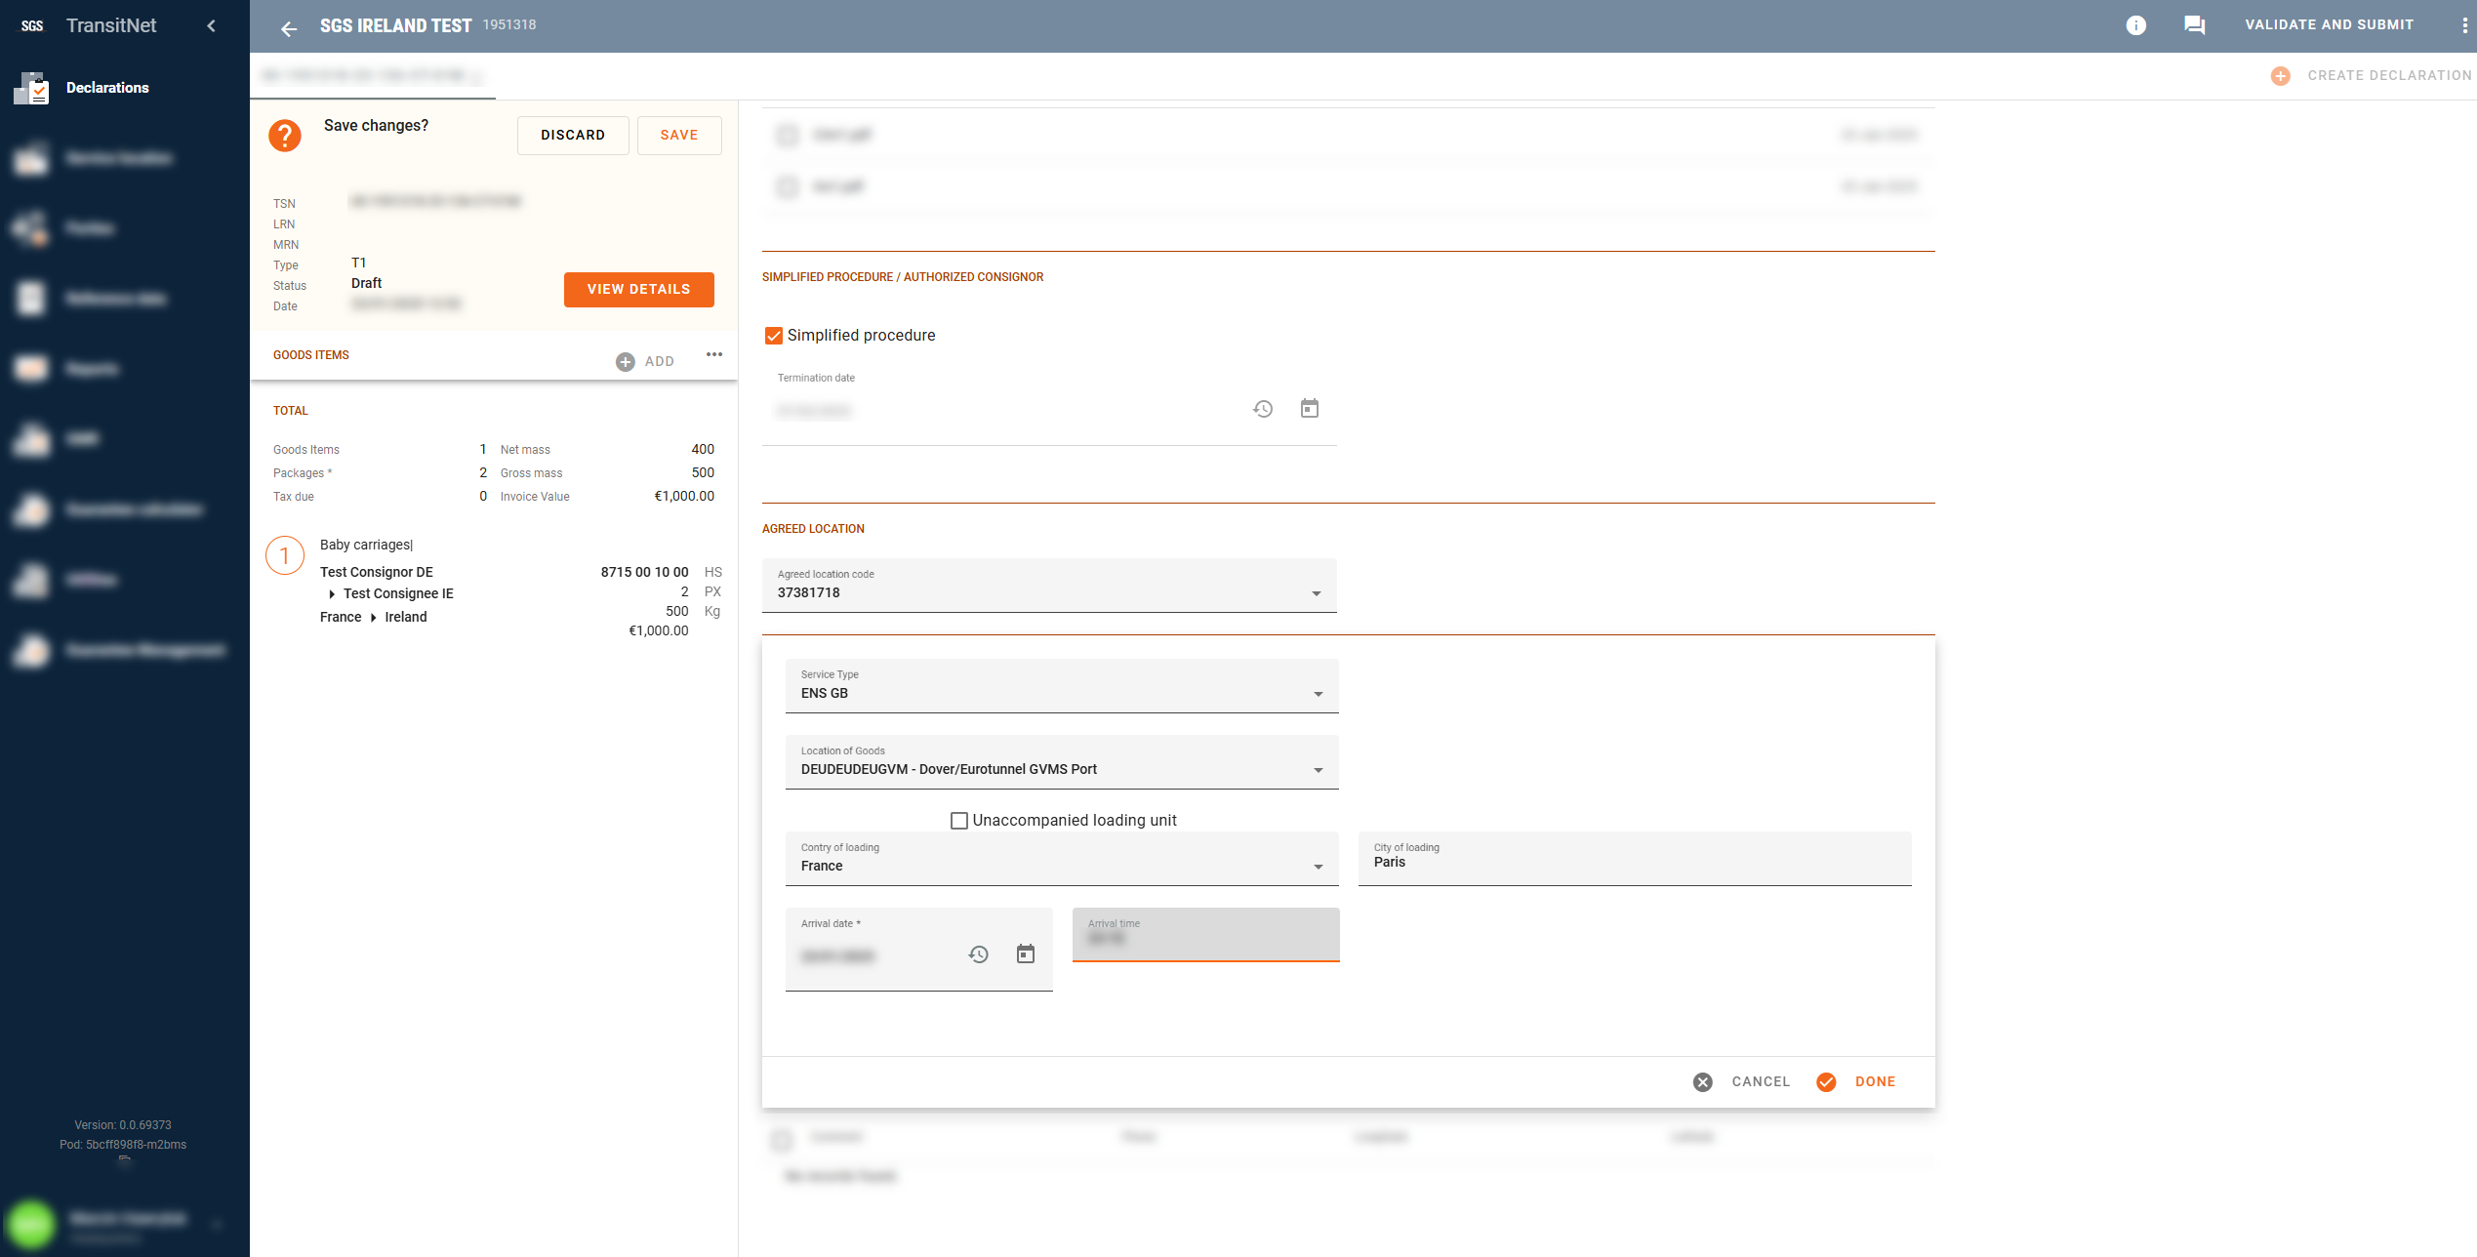
GB ENS AS AN ADDITIONAL SERVICE
For unaccompanied transports, check the Unaccompanied loading unit box
Complete:
•Country of loading
•Place of loading
•Arrival date (arrival date of ferry/tunnel into GB)
•Arrival time (arrival date of ferry/tunnel into GB)
Press DONE to continue

Slide 16
GB ENS AS AN ADDITIONAL SERVICE
After submission of the transits, ENS will be generated. Successful ENS submission is shown as below
Click inside to see declaration reference numbers information

Slide 17
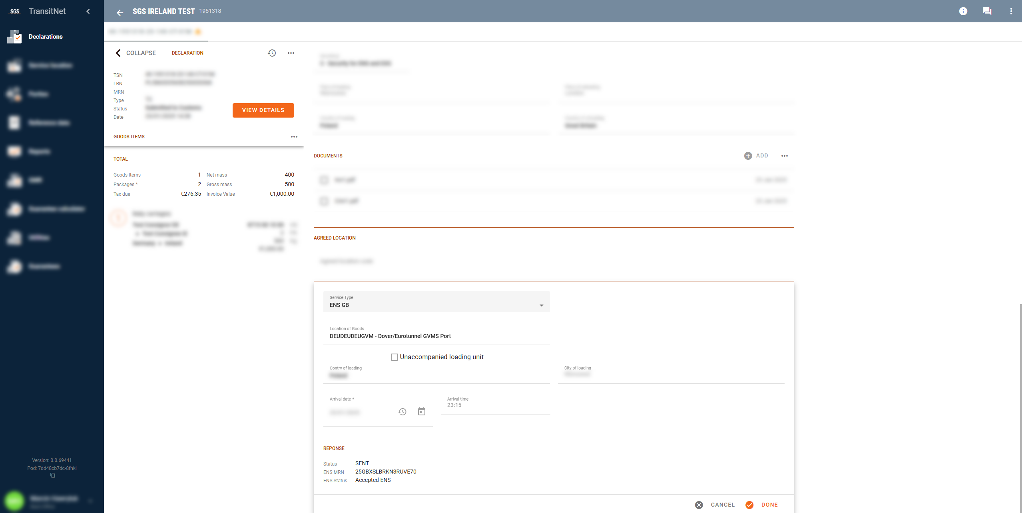
GB ENS AS AN ADDITIONAL SERVICE
In case of rejected ENS submissions, please contact your local Client Centre
Information about accepted and rejected ENS submissions will also be sent by no reply email message to your registered email addresses

Slide 18
WWW.SGS.COM

